Slide 1
Overview of MPEG
Sathish R

Slide 2
Agenda
Compression
Compression Technique
What is MPEG Video Coding
MPEG – Types.

Slide 3
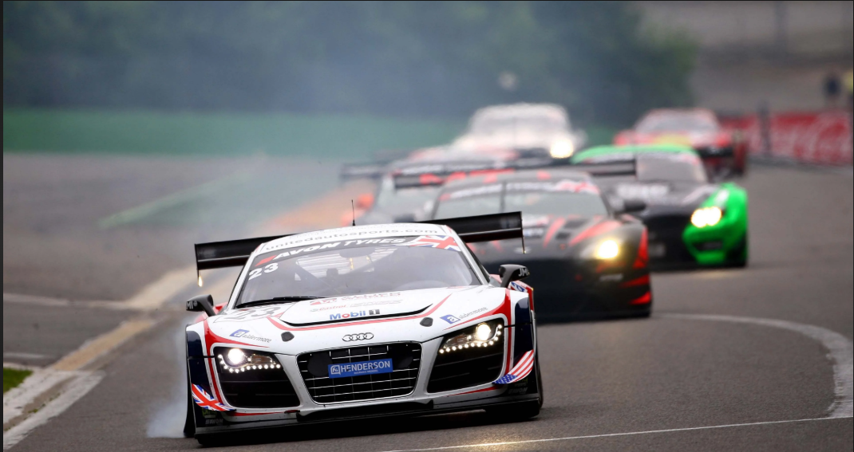
Car in a race

Slide 4
Compression
Why its needed.

Slide 5

Compression (2)
Data Compression converts an input data stream to another data steam of a smaller size.
Raw Data => Encoder -> Network -> Decoder => Uncompressed Data.
Raw Data
Internet/NET
Decoder
Uncompressed Data
Encoder

Slide 6



Compression (3)
Why Compression ?
Reduced Storage Space.
Reduces Bandwidth.
Communication Cost is very less.
New application can make use of it.
On Devices like

Slide 7
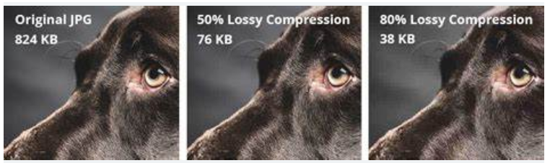
Compression (4)
Types of Compression.
Lossless Compression – Does not eliminate the data which is not noticeable.
Lossy Compression. – not noticeable data generally removed.

Slide 8
Compression(5)– LossY vs Lossless Compression
Lossy Compression | Lossless Compression
Lossy compression is the method which eliminate the data which is not noticeable. | While Lossless Compression does not eliminate the data which is not noticeable.
In Lossy compression, A file does not restore or rebuilt in its original form. | While in Lossless Compression, A file can be restored in its original form.
In Lossy compression, Data’s quality is compromised. | But Lossless Compression does not compromise the data’s quality.
Lossy compression reduces the size of data. | But Lossless Compression does not reduce the size of data.
Algorithms used in Lossy compression are: Transform coding, Discrete Cosine Transform, Discrete Wavelet Transform, fractal compression etc. | Algorithms used in Lossless compression are: Run Length Encoding, Huffman Coding, Arithmetic encoding etc.
Lossy compression is used in Images, audio, video. | Lossless Compression is used in Text, images, sound.
Lossy compression has more data-holding capacity. | Lossless Compression has less data-holding capacity than Lossy compression technique.
Lossy compression is also termed as irreversible compression. | Lossless Compression is also termed as reversible compression.

Slide 9
What is MPEG
MPEG
Its Moving Picture Expert Group.
Established in 1988 for the development of digital video.
Proprietary interests need to be mentioned within the family MPEG standards.

Slide 10
What is MPEG (2)
MPEG stands for Motion Pictures Expert Group 
It is ISO standard for Video and Audio.
MPEG standard also support online Audio and Video 
MPEG also refer the family of Digital Video Compression standard and file formats of this group
MPEG algorithm show better compression so video data can be easily communicated through on-line channel and easily decompressed at receiver site.

Slide 11
What is MPEG (3)
MPEG follow lossy compression Technique for the compression of Video data. 
The video data which is not relevant to visualization of human eyes these data is removed from the video that’s why Video Compression follow lossy compression. 
MPEG show high compression rate because it store difference of frames rather than entire frame of video.

Slide 12
What is MPEG(4) - types
MPEG1
MPEG2
MPEG3
MPEG4
MPEG7

Slide 13
MPEG1
Approved in Nov 1992 Standard for lossy video/audio compression.
Developed by ISO,IEC.
Designed to compress VHS-quality raw digital video and CD audio down to 1.5 Mbit/s.
Provide coding of Video and its associated Audio with speed 1.5 MBPS for digital storage media
Extension of JPEG ,H.261.
Only supports progressive pictures.

Slide 14
MPEG Video Coding
MPEG-1: Designed for non-interlaced video formats, primarily targeting bit rates up to about 1.5 Mbit/s.​
MPEG-2: Developed to handle interlaced video formats, supporting higher bit rates (approximately 5 to 30 Mbit/s), suitable for high-quality and high-definition video applications.
The MPEG-2 standard was first published in 1994 as ISO/IEC 13818, again comprising three parts ± systems, video and audio

Slide 15
MPEG – video Coding Principles
Spatial and Temporal Redundancy: Exploits the similarities between neighboring pixels within a frame (spatial) and across consecutive frames (temporal).​
Entropy Redundancy: Utilizes the statistical occurrence of pixel values, assigning shorter codes to more frequent values to achieve compression.​
Psycho-visual Redundancy: Leverages the limitations of human vision, such as reduced sensitivity to fine details and fast motion, to remove less perceptible information.

Slide 16
MPEg – VIDEO CODING PRINCIPLES(2)- Spatial
Many images have areas where pixel values are similar, especially in regions of smooth surfaces or objects with little texture. Compression algorithms can take advantage of this by representing these areas with fewer bits than if each pixel's value were stored individually.
For example, if a large portion of an image is a solid color, it's more efficient to represent that area with a single-color code rather than individual pixel values for each pixel.

Slide 17
MPEg – VIDEO CODING PRINCIPLES(2)- Temporal
In video, consecutive frames often have significant overlap. Rather than storing each frame in its entirety, compression algorithms can store only the differences between frames, or motion vectors, and then re-create the video by combining these changes with previous frames.
This approach can significantly reduce the amount of data needed to store or transmit video.

Slide 18
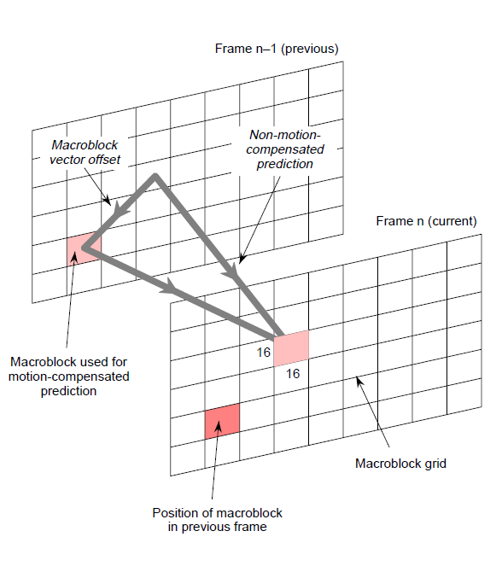

Slide 19
MPEG – VIDEO CODING PRINCIPLES(4) - EnTROPY
For any non-random digitized signal, some code values occur more frequently than others. This can be exploited by coding the more frequently occurring values with shorter codes than the rarer ones.
This same principle has long been exploited in Morse code where the most common letters in English, ‘E’ and ‘T’, are represented by one dot and one dash, respectively, whereas the rarest letters, ‘X’, ‘Y’ and ‘Z’, are each represented by a total of four dots and dashes.
Notes:
https://morsecode.world/international/morse2.html

Slide 20
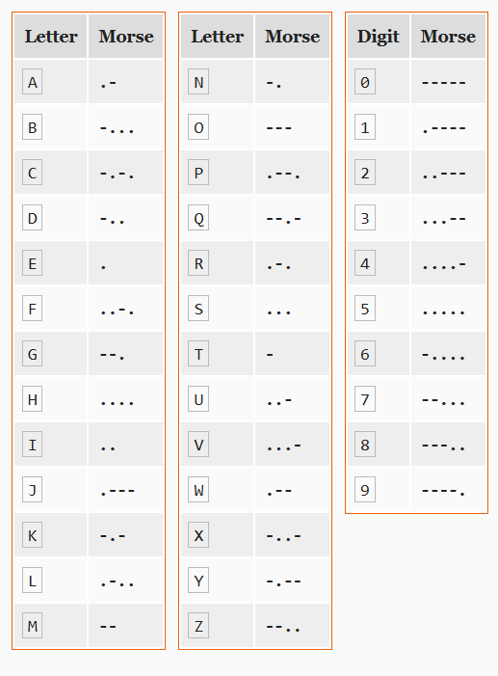

Slide 21
MPEG – VIDEO CODING PRINCIPLES(4)
MPEG video compression works by reducing both spatial and temporal redundancy.
It achieves this through techniques like
Discrete Cosine Transform (DCT),
motion compensation, and variable length coding.
The process involves frame grouping, motion vector prediction, and encoding/decoding of I, P, and B frames to minimize data while maintaining quality.

Slide 22
MPEG in DETAIL - Preprocessing:
Color Space Conversion: MPEG often uses YCbCr, a color space that separates luminance (Y) and chrominance (Cb, Cr) information. This separation is beneficial for compressing video, as human vision is less sensitive to changes in chrominance.
Downsampling: The chrominance information (Cb, Cr) is often downsampled to reduce the amount of data, as human vision is more sensitive to changes in luminance than chrominance

Slide 23
MPEG in DETAIL(2) - Intraframe Compression (Spatial Redundancy Reduction):
Macroblock Division: The video frame is divided into 8x8 pixel macroblocks. These are the basic units of processing for MPEG.
Discrete Cosine Transform (DCT): Each macroblock is transformed using DCT, which converts pixel data from the spatial domain to the frequency domain. This concentrates the energy of the image into a few low-frequency coefficients.
Quantization: The DCT coefficients are quantized, meaning some of the less important high-frequency coefficients are discarded or reduced in value, leading to further compression.

Slide 24
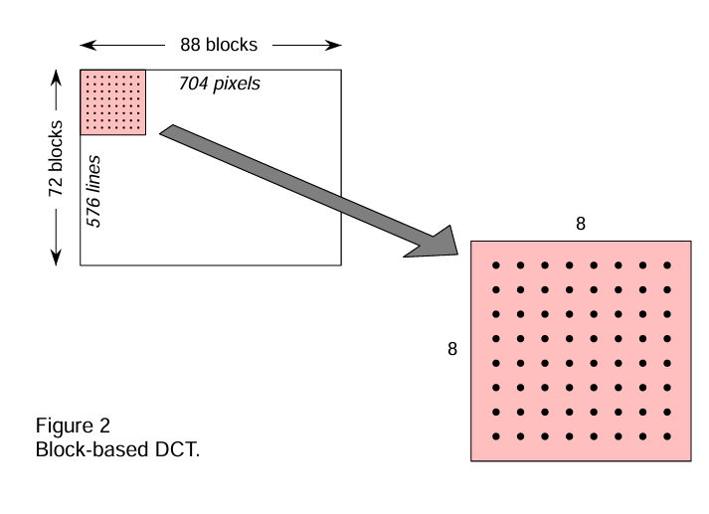

Slide 25
MPEG in DETAIL(3) - Intraframe Compression (Spatial Redundancy Reduction):
Zigzag Scanning: The quantized coefficients are scanned in a zigzag pattern, which puts the most significant coefficients at the beginning of the sequence.
Variable Length Coding (VLC): The zigzag scanned coefficients are then encoded using VLC, such as Huffman coding or arithmetic coding. VLC assigns shorter codes to more frequent values, further reducing the data size.

Slide 26
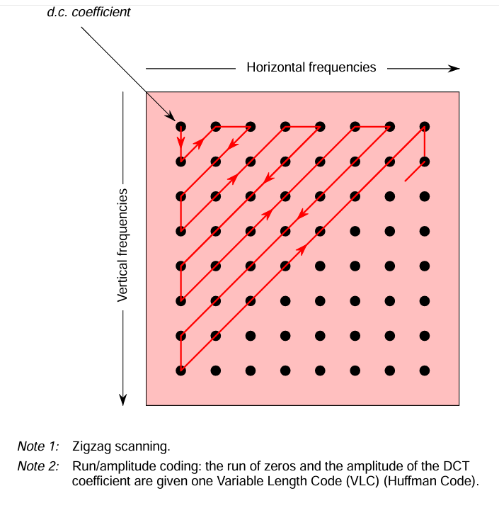

Slide 27
MPEG in DETAIL (4) - Interframe Compression (Temporal Redundancy Reduction):
Frame Types: MPEG uses three frame types:
I-frames (Intra-coded),
P-frames (Predictive-coded), and
B-frames (Bidirectional-coded).
I-frames: These are like JPEG frames, capturing the entire frame's information and serving as a reference point for future frames.
P-frames: These are encoded based on their difference from the previous I-frame or P-frame, utilizing motion compensation to predict how objects have moved between frames.
B-frames: These are encoded based on differences from both a previous and a future I-frame or P-frame. This allows for better compression of smoothly moving objects.

Slide 28
MPEG in DETAIL (5) - Motion Estimation and Compensation:
MPEG identifies and encodes motion vectors, which describe the movement of objects between frames. This reduces the need to encode the entire frame, especially when the background is static.

Slide 29
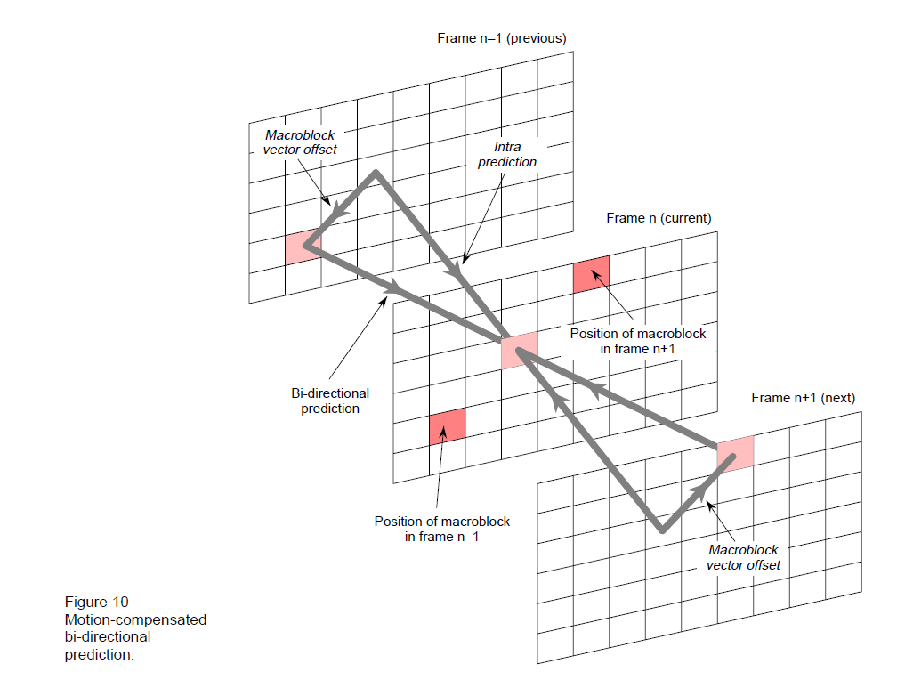

Slide 30
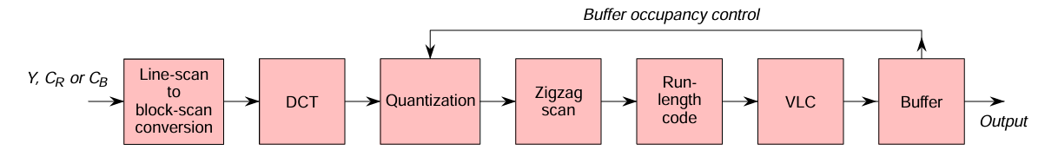

Slide 31
MPEG in detail (6) - Encoding:
The compressed data is organized into a bitstream, which includes headers for information like frame type, resolution, and motion vectors.

Slide 32
MPEG in DETAIL (7) - Decoding:
The decoder reads the bitstream and reconstructs the video frames by performing the reverse of the encoding process.
It uses the I-frames as a reference, the P-frames based on the previous frame, and the B-frames based on both previous and future frames.
Motion compensation is used to reconstruct the video frames by moving the encoded parts of the video to their respective positions in the frame

Slide 33
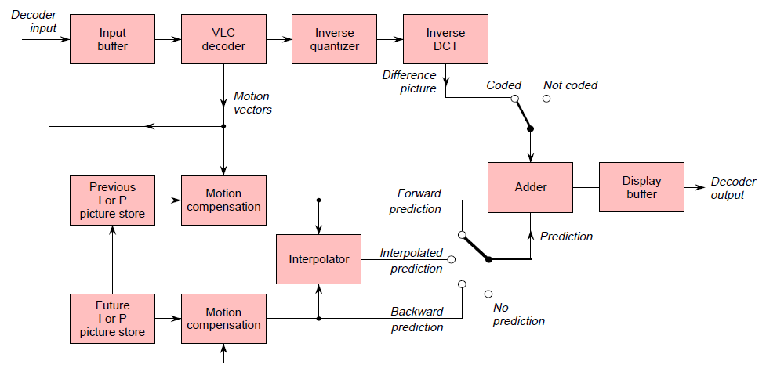

Slide 34
MPEG2
MPEG-2 (Moving Picture Experts Group-2) is a digital video and audio compression standard developed by the MPEG group.
It was introduced in 1995 as an improvement over MPEG-1 and became widely used in broadcasting, DVDs, and digital television (DTV).

Slide 35
MPEG2
Supports both standard definition (SD) and high definition (HD) video.
Uses interlaced video (useful for broadcast TV).
Better compression efficiency than MPEG-1.
Supports multi-channel audio (e.g., 5.1 surround sound).
Used in DVDs, digital TV (DVB, ATSC), and satellite broadcasting.

Slide 36
MPEG1 vs MPEG2
Feature | MPEG-1 | MPEG-2
Resolution | Designed for low-resolution (e.g., 352×240/288) | Supports higher resolutions (up to 1920×1080 for HD)
Interlacing | Only progressive scan | Supports interlaced video (better for broadcast TV)
Bitrate | Up to 1.5 Mbps (VCD quality) | Much higher (up to 15-80 Mbps for DVDs, broadcast)
Audio | Stereo (MP1, MP2, MP3) | Multi-channel (AC-3, AAC, MP2)
Applications | Video CDs (VCDs), early web streaming | DVDs, Digital TV (DVB, ATSC), Satellite TV
Compression Efficiency | Basic DCT compression | Improved motion prediction & scalability

Slide 37
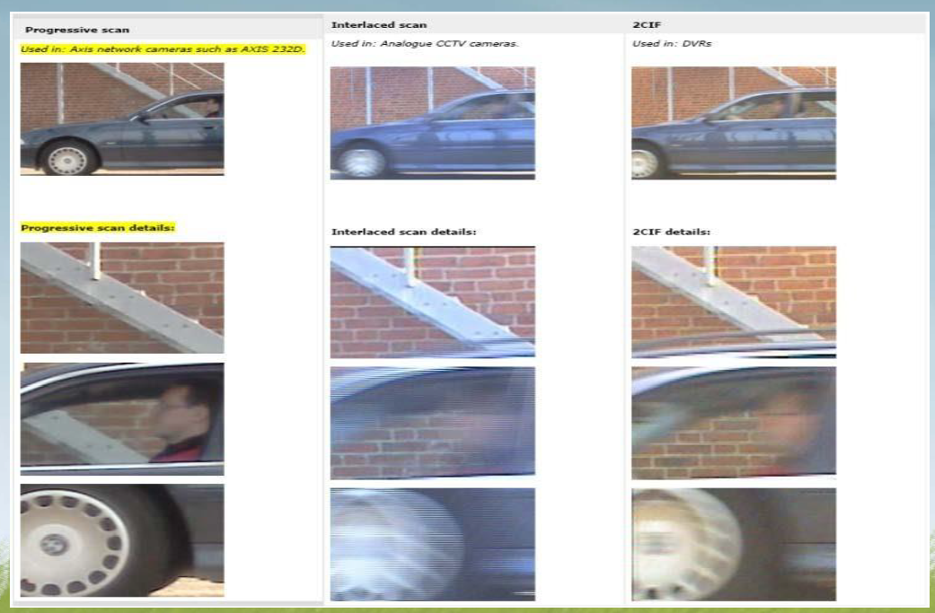
MPEG-2

Slide 38



1080P and 1080i

Slide 39
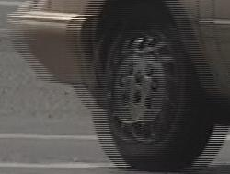
MPEG-2 Interlaced - ComBING
When someone watches interlaced video on a progressive monitor with poor (or no) deinterlacing,
they can see "combing" in movement between two fields of one frame.

Slide 40
MPEG-2 Disadvantage
MPEG2 takes more CPU power to decompress and basically has no advantage over MPEG1 at lower resolutions.
If you're distributing for the web, you're not going to want to be compressing stuff in MPEG2 instead of MPEG1 because the benefits of MPEG2 aren't realized until you get into full TV resolution.

Slide 41
MPEG 3
Initially, MPEG-3 was planned for HDTV applications, but it was merged into MPEG-2 because MPEG-2 already handled HDTV requirements.
Thus, MPEG-3 was abandoned.
MP3 (MPEG-1 Layer 3), it is a widely used audio compression format, not to be confused with a non-existent "MPEG-3" video standard.

Slide 42
MPEG4 - Overview
MPEG-4 (officially ISO/IEC 14496) is a multimedia standard developed by the Moving Picture Experts Group (MPEG) and first released in 1999.
Unlike earlier MPEG standards (MPEG-1, MPEG-2), which focused primarily on video and audio compression, MPEG-4 is a more versatile standard designed for:
Digital TV
Video streaming (e.g., YouTube, Netflix)
Video conferencing (e.g., Zoom, Skype)
Interactive multimedia (e.g., games, VR)
Mobile and web applications

Slide 43
MPEG4 - Overview
MPEG-4 (officially ISO/IEC 14496) is a multimedia standard developed by the Moving Picture Experts Group (MPEG) and first released in 1999.
Unlike earlier MPEG standards (MPEG-1, MPEG-2), which focused primarily on video and audio compression, MPEG-4 is a more versatile standard designed for:
Digital TV , Video streaming (e.g., YouTube, Netflix).
Video conferencing (e.g., Zoom, Skype) , Interactive multimedia (e.g., games, VR).
Mobile and web applications.

Slide 44
MPEG4 – Key Features
Advanced Compression (Better Quality at Lower Bitrates)
Uses object-based coding (not just frame-based like MPEG-2).
Supports H.264 (AVC) and H.265 (HEVC) for high-efficiency video.
Better compression than MPEG-2 (e.g., same quality at half the file size).

Slide 45
MPEG4 – Key Features(2)
Support for Multiple Media Types
Video: MPEG-4 Part 2 (DivX, Xvid), H.264/AVC (Part 10), H.265/HEVC (Part 12).
Audio: AAC (Advanced Audio Coding) – better than MP3.
3D & VR: Supports 3D graphics, facial animation, and VRML.
Text & Subtitles: Embedded subtitles and metadata.

Slide 46
MPEG4 – Key FeaTUREs(3)
Streaming & Internet-Friendly
Designed for real-time streaming (used in DASH, HLS).
Supports adaptive bitrate streaming (adjusts quality based on network speed).
DRM & File Formats
MP4 (.mp4) – Most common container for MPEG-4 video.
MOV (.mov) – Apple’s QuickTime format (often uses MPEG-4).
3GP (.3gp) – Used for mobile phones.
DRM Support (Digital Rights Management) for secure content.

Slide 47
MPEG4 - Key FEATURES
MPEG-4 Parts (Important Sub-Standards)
Part | Name | Description
Part 2 | MPEG-4 Visual | Early video codec (DivX, Xvid)
Part 3 | MPEG-4 Audio (AAC) | Advanced Audio Coding (better than MP3)
Part 10 | H.264/AVC | Most widely used video codec (Blu-ray, YouTube)
Part 12 | ISO Base Media Format | Basis for MP4, 3GP, Apple QuickTime
Part 14 | MP4 File Format | Standard .mp4 container
Part 25 | 3D Graphics Compression | For VR and 3D applications

Slide 48
MPEG4 vs MPEG3 vs MPEG1
MPEG-4 vs. MPEG-2 vs. MPEG-1
Feature | MPEG-1 (1993) | MPEG-2 (1995) | MPEG-4 (1999)
Main Use | VCD, MP3 | DVD, Digital TV | Streaming, Mobile, Web
Compression | Low | Medium | High (H.264, HEVC)
Internet Use | No | Limited | Yes (Adaptive Streaming)
File Formats | .mpg, .mp3 | .mpg, .vob | .mp4, .mov, .3gp

Slide 49
MPEG4 – Object Coding
The scene is split into separate objects (background, person, text).
Each object is:
Segmented (shape coding).
Compressed independently (texture/motion coding).
Reassembled during playback.

Slide 50
MPEG4 – Object Coding
Most of the features included in MPEG-4 are left to individual developers to decide whether or not to implement.
This means that there are probably no complete implementations of the entire MPEG-4 set of standards.
To deal with this, the standard includes the concept of "profiles" and "levels", allowing a specific set of capabilities to be defined in a manner appropriate for a subset of applications.

Slide 51
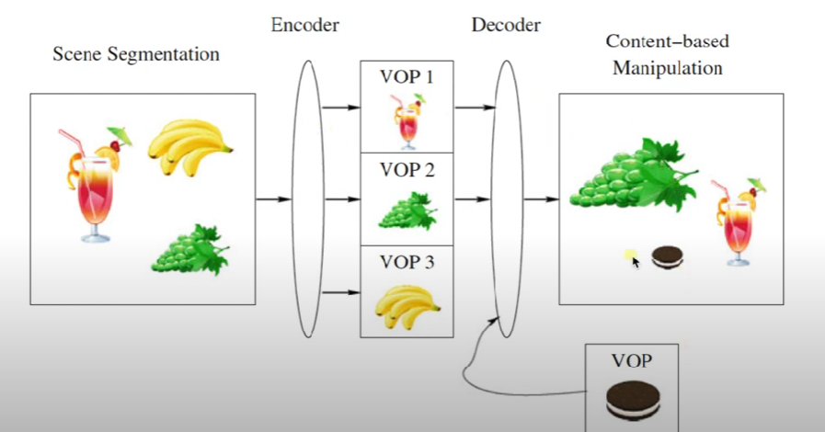
MPEG4 – OBJECT CODING

Slide 52
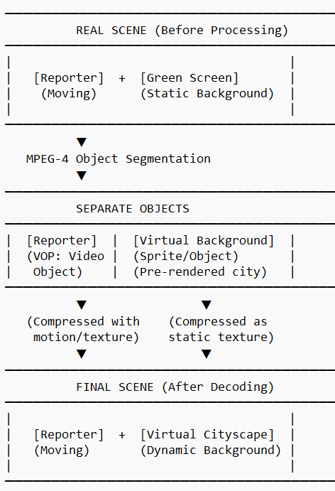
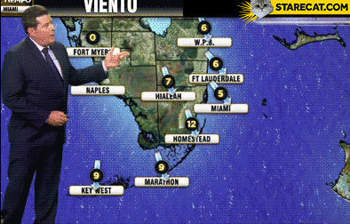
MPEG4 – Virtual NEWS BROADCAST

Slide 53
MPEG4 – Virtual NEWS Broadcast(2)
Bandwidth Savings: Only the reporter’s movements are transmitted, not the entire frame.
Real-Time Editing: The background can be swapped (e.g., from daytime to nighttime).
Augmented Reality (AR): Overlay graphics (e.g., weather maps) as additional objects.

Slide 54
MPEG4 -
Real-World Use Cases:
Sports Broadcasting: Overlay player stats as separate objects.
Video Conferencing: Replace your background (Zoom/Teams virtual backgrounds).
Gaming: Mix real-world objects with CGI elements.

Slide 55
MPEG4 - Interactive TV with Object-Based Coding
How Viewers Choose Camera Angles
Object-based coding allows a TV broadcast (e.g., sports, concerts) to transmit multiple camera angles as separate objects, letting viewers select their preferred perspective in real time.

Slide 56
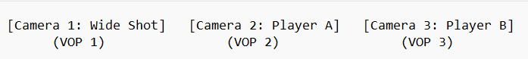
MPEG4 - Interactive TV with Object-Based Coding
1. Scene Capture & Object Separation
A live event (e.g., football game) is filmed by multiple cameras (wide-angle, player close-up, overhead drone, etc.).
Each camera feed is treated as an independent video object (VOP).
2. Encoding & Transmission
Each camera angle is compressed separately using MPEG-4 object coding.
Additional objects (e.g., scoreboard, ads) are also encoded independently.
All objects are sent as a single stream with metadata describing their spatial/temporal relationships.

Slide 57
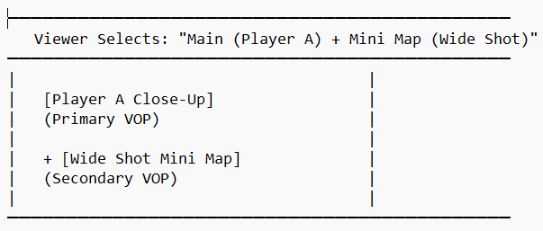
MPEG4 - Interactive TV with Object-Based Coding
3. Viewer Interaction
The viewer’s device (smart TV, app) receives all objects but only decodes the selected angle(s).
Example commands:
"Show wide shot + Player A PIP (Picture-in-Picture)"
"Switch to drone view"
4. Dynamic Scene Assembly
The decoder combines objects in real time based on user input:

Slide 58
MPEG-4 Part 10 / H.264 (AVC)
1. MPEG-4 Part 10 (H.264 / AVC)
Full Name: Advanced Video Coding (AVC)
Standard: MPEG-4 Part 10 / ITU-T H.264
Primary Use: High-efficiency video compression for broadcasting, streaming, Blu-ray, and video conferencing
Key Features:
Better compression than MPEG-2 (~50% smaller at same quality).
Supports multiple profiles (Baseline, Main, High).
Uses CABAC (Context-Adaptive Binary Arithmetic Coding) for better efficiency.
Widely adopted in YouTube, Netflix, Blu-ray, IP cameras, and video calls (Zoom, Skype).

Slide 59
MPEG-4 Part 10 / H.264 (SVC)
Extension of H.264 - that adds scalability for adaptive streaming.
Primary Use: Video conferencing, surveillance, and multicast streaming.
Key Features:
Layered encoding: Base layer (low quality) + enhancement layers (higher quality).
Three types of scalability:
Temporal (frame rate): Lower layers have fewer frames.
Spatial (resolution): Lower layers are downscaled.
Quality (bitrate): Lower layers use coarser quantization.
Benefits:
Adaptive streaming: Clients receive only the layers they need.
Error resilience: If network drops packets, base layer remains intact.

Slide 60
MPEG4 – AVC vs SVC
Comparison: H.264/(AVC) vs. H.264/SVC
Feature | H.264/(AVC) | H.264/SVC
Compression | Single-layer | Multi-layered
Use Case | Blu-ray, streaming | Video calls, multicast
Adaptability | Fixed bitrate/res | Dynamically adjustable
Complexity | Lower encoding/decoding | Higher complexity
Adoption | Universal (Netflix, YouTube) | Niche (WebRTC, surveillance)

Slide 61
MPEG Audio & Commercial Audio Codecs
MPEG (Moving Picture Experts Group) has developed several audio compression standards, widely used in broadcasting, streaming, and consumer electronics.
Below is a breakdown of MPEG audio codecs and their commercial implementations.

Slide 62
MPEG Audio Standards
A. MPEG-1 Audio (1993)
Layers:
MP1 (Layer 1) – Simplest, used in DCC (Digital Compact Cassette).
MP2 (Layer 2) – Used in DVDs, SVCDs, and digital broadcasting (DAB).
MP3 (Layer 3) – Most popular, revolutionized digital music.
Codec | Bitrate (Typical) | Use Case
MP1 | 384 kbps | Obsolete (early DCC)
MP2 | 256–384 kbps | Broadcast TV, DVDs
MP3 | 128–320 kbps | Music streaming (early)

Slide 63
MPEG Audio Standards
B. MPEG-2 Audio (1995)
AAC (Advanced Audio Coding) – Better than MP3, adopted for iTunes, YouTube.
MPEG-2 BC (Backward Compatible) – Extends MPEG-1 for 5.1 surround sound.
Codec | Bitrate (Typical) | Use Case
AAC | 96–256 kbps | Streaming (Spotify, Apple)
MP2-MC | 384–512 kbps | Early surround sound

Slide 64
MPEG Audio Standards
C. MPEG-4 Audio (1999+)
AAC-LC (Low Complexity) – Standard for music (iTunes, YouTube).
HE-AAC (High Efficiency AAC) – Optimized for low-bitrate (DAB+, streaming).
ALS (Audio Lossless Coding) – FLAC-like lossless compression.
USAC (Unified Speech & Audio Coding) – Combines music/speech efficiently.
Codec | Bitrate (Typical) | Use Case
AAC-LC | 128–256 kbps | Apple Music, Netflix
HE-AAC | 48–128 kbps | Low-bitrate radio (DAB+)
USAC | 24–64 kbps | Voice assistants, audiobooks

Slide 65
NON MPEG – Commercial Audio CODECS
Many proprietary codecs compete with MPEG standards for better efficiency or licensing terms.
A. Lossy Codecs (For Streaming & Phones)
Codec | Developer | Bitrate Range | Key Use Case
Opus | Xiph/Mozilla | 6–512 kbps | VoIP (Discord, WhatsApp)
AC-3 (Dolby Digital) | Dolby | 192–640 kbps | DVDs, Blu-ray, TV
DTS | DTS, Inc. | 768–1536 kbps | Cinema, Blu-ray
LDAC | Sony | 330–990 kbps | High-res Bluetooth audio
aptX | Qualcomm | 352 kbps | Wireless headphones

Slide 66
NON MPEG – Commercial Audio CODECS
B. Lossless Codecs (For Audiophiles)
Codec | Developer | Compression Ratio | Use Case
FLAC | Xiph.org | ~50% | Music archiving
ALAC | Apple | ~40–60% | iTunes lossless
WAV | Microsoft | None (raw PCM) | CD ripping
DSD | Sony/Philips | None (1-bit) | Super Audio CD (SACD)

Slide 67
Future of AUDIO CODECS
MPEG-H 3D Audio – Used in next-gen broadcasts (ATSC 3.0) for immersive sound.
Opus – Dominating VoIP and low-latency applications.
AI-based Codecs – Like Lyra (Google) for ultra-low-bitrate speech. – wiki page link -
https://en.wikipedia.org/wiki/Lyra_(codec)
Google Meet uses Lyra to transmit sound for video chats when bandwidth is limited

Slide 68
MPEGI – for IMMERSIVE MEDIA
Immersive Media refers to digital experiences that make users feel like they are inside or part of a virtual environment.
It blends the real the virtual worlds using technologies.
Virtual Reality (VR) - (full 3D worlds)
Augmented Reality (AR) - (adding virtual elements to real scenes)
360° Videos - (watching all around you)
Holograms and Spatial Audio

Slide 69
MPEGI – FOR IMMERSIVE MEDIA(2)
MPEG-I (officially ISO/IEC 23090) is a suite of standards developed by the Moving Picture Experts Group (MPEG) for next-generation immersive media, including VR (Virtual Reality), AR (Augmented Reality), 360° video, and 3D audio.
It builds on MPEG-4’s object-based coding but focuses on
interactivity,
3D environments, and
volumetric content.

Slide 70
MPEGI – KEY FEATURES
1. Volumetric Video (6DoF)
What it does: Captures real-world objects/scenes in 3D, allowing viewers to move freely (6 Degrees of Freedom - 6DoF).
Example:
A basketball game where you can walk around players in VR.
A holographic concert where you view the artist from any angle.
2. Omnidirectional (360°) Video
What it does: Encodes spherical video for VR headsets.
Example:
YouTube 360° videos where you look around by moving your phone/headset.

Slide 71
MPEGI – KEY FEATURES
3. Point Cloud Compression (PCC)
What it does: Efficiently compresses 3D scans of real-world objects (used in AR/autonomous vehicles).
Example:
A LiDAR scan of a historic monument for virtual tourism.
4. Immersive Audio (MPEG-H 3D Audio)
What it does: Spatial audio that changes dynamically with head movement.
Example:
Hearing a helicopter fly overhead in a VR war game.

Slide 72
MPEG1 Vs MPEG4
Feature | MPEG-4 (1999) | MPEG-I (2017+)
Focus | 2D Video + Objects | 3D/VR/AR
Interactivity | Limited (clickable UI) | 6DoF Movement
Compression | H.264/AVC | VVC (H.266), PCC
Audio | Stereo/AAC | 3D Spatial Audio
Use Cases | Streaming, DVDs | Metaverse, VR Chat

Slide 73
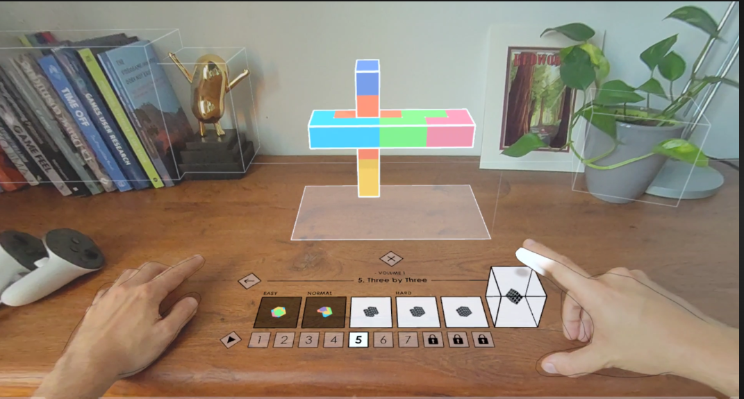
MPEG1 – REAL WORLD APPLICATION
Meta Quest Games :

Slide 74
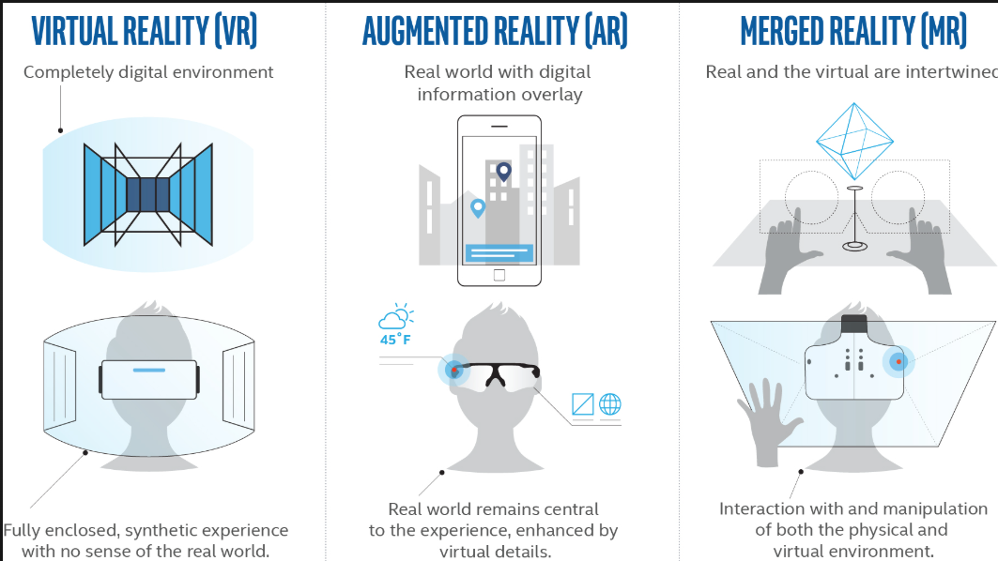
MPEG1 – REAL WORLD APPLICATION

Slide 75
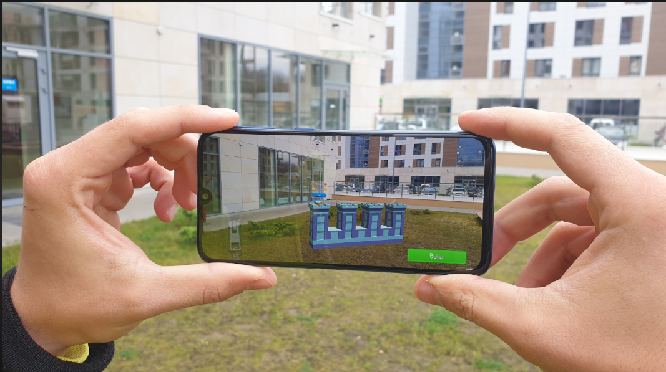
MPEGI – REAL WORLD APPLICATION

Slide 76
MPEGI – REAL WORLD APPLICATION
Live Events & Sports
Example: Watching a concert in VR with multiple stage angles.
Tech Used: Omnidirectional video + MPEG-H audio.

